Slide 1
Chapter 2
Network Models

Slide 2
2-1 LAYERED TASKS
We use the concept of layers in our daily life. As an example, let us consider two friends who communicate through postal mail. The process of sending a letter to a friend would be complex if there were no services available from the post office.
Topics discussed in this section:
Sender, Receiver, and Carrier
Hierarchy

Slide 3
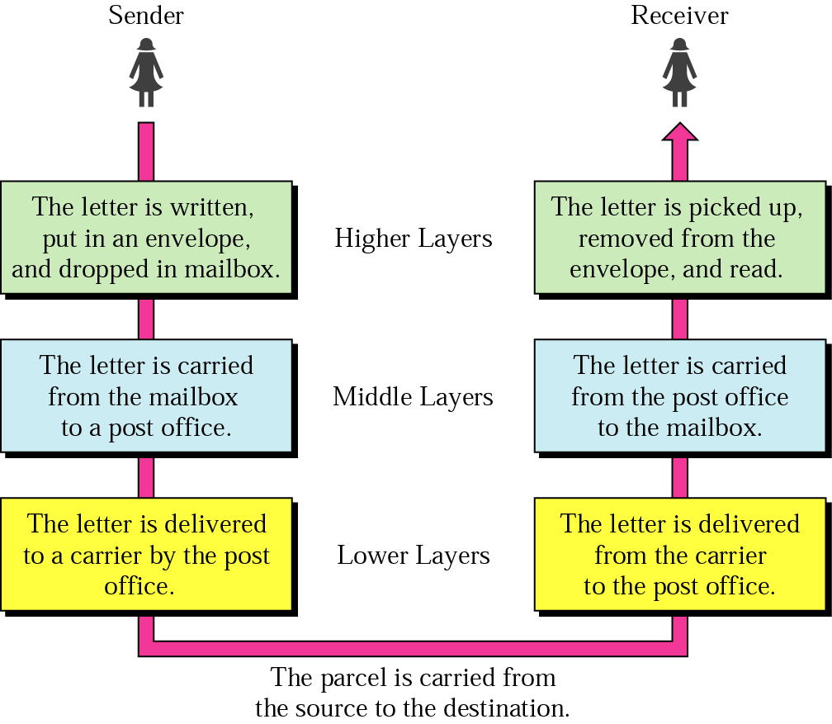



Figure 2.1 Tasks involved in sending a letter

Slide 4
2-2 THE OSI MODEL
Established in 1947, the International Standards Organization (ISO) is a multinational body dedicated to worldwide agreement on international standards. An ISO standard that covers all aspects of network communications is the Open Systems Interconnection (OSI) model. It was first introduced in the late 1970s.
Topics discussed in this section:
Layered Architecture
Peer-to-Peer Processes
Encapsulation

Slide 5

Note
ISO is the organization.
OSI is the model.

Slide 6

Figure 2.2 Seven layers of the OSI model

Slide 7

Figure 2.3 The interaction between layers in the OSI model

Slide 8

Figure 2.4 An exchange using the OSI model

Slide 9
2-3 LAYERS IN THE OSI MODEL
In this section we briefly describe the functions of each layer in the OSI model.
Topics discussed in this section:
Physical Layer
Data Link Layer
Network Layer
Transport Layer
Session Layer
Presentation Layer
Application Layer

Slide 10

Figure 2.5 Physical layer

Slide 11
Note
The physical layer is responsible for movements of
individual bits from one hop (node) to the next.

Slide 12
Functions of Physical Layer
Representation of Bits: Data in this layer consists of stream of bits. The bits must be encoded into signals for transmission. It defines the type of encoding i.e. how 0's and 1's are changed to signal.
Data Rate: This layer defines the rate of transmission which is the number of bits per second.
Synchronization: It deals with the synchronization of the transmitter and receiver. The sender and receiver are synchronized at bit level.
Interface: The physical layer defines the transmission interface between devices and transmission medium.
Line Configuration: This layer connects devices with the medium: Point to Point configuration and Multipoint configuration.
Topologies: Devices must be connected using the following topologies: Mesh, Star, Ring and Bus.
Transmission Modes: Physical Layer defines the direction of transmission between two devices: Simplex, Half Duplex, Full Duplex.
Deals with baseband and broadband transmission.

Slide 13

Figure 2.6 Data link layer

Slide 14
Note
The data link layer is responsible for moving
frames from one hop (node) to the next.

Slide 15
Functions of Data Link Layer
Framing: Frames are the streams of bits received from the network layer into manageable data units. This division of stream of bits is done by Data Link Layer.
Physical Addressing: The Data Link layer adds a header to the frame in order to define physical address of the sender or receiver of the frame, if the frames are to be distributed to different systems on the network.
Flow Control: A flow control mechanism to avoid a fast transmitter from running a slow receiver by buffering the extra bit is provided by flow control. This prevents traffic jam at the receiver side.
Error Control: Error control is achieved by adding a trailer at the end of the frame. Duplication of frames are also prevented by using this mechanism. Data Link Layers adds mechanism to prevent duplication of frames.
Access Control: Protocols of this layer determine which of the devices has control over the link at any given time, when two or more devices are connected to the same link.

Slide 16

Figure 2.7 Hop-to-hop delivery

Slide 17

Figure 2.8 Network layer

Slide 18
Note
The network layer is responsible for the
delivery of individual packets from
the source host to the destination host.

Slide 19
Functions of Network Layer
It translates logical network address into physical address. Concerned with circuit, message or packet switching.
Routers and gateways operate in the network layer. Mechanism is provided by Network Layer for routing the packets to final destination.
Connection services are provided including network layer flow control, network layer error control and packet sequence control.
Breaks larger packets into small packets.

Slide 20

Figure 2.9 Source-to-destination delivery

Slide 21

Figure 2.10 Transport layer

Slide 22
Note
The transport layer is responsible for the delivery
of a message from one process to another.

Slide 23
Functions of Transport Layer
Service Point Addressing : Transport Layer header includes service point address which is port address. This layer gets the message to the correct process on the computer unlike Network Layer, which gets each packet to the correct computer.
Segmentation and Reassembling : A message is divided into segments; each segment contains sequence number, which enables this layer in reassembling the message. Message is reassembled correctly upon arrival at the destination and replaces packets which were lost in transmission.
Connection Control : It includes 2 types :
  Connectionless UDP Transport Layer : Each segment is considered as an independent packet and delivered to the transport layer at the destination machine.
  Connection Oriented Transport Layer : TCP Before delivering packets, connection is made with transport layer at the destination machine.
Flow Control : In this layer, flow control is performed end to end.
Error Control : Error Control is performed end to end in this layer to ensure that the complete message arrives at the receiving transport layer without any error. Error Correction is done through retransmission

Slide 24

Figure 2.11 Reliable process-to-process delivery of a message

Slide 25
Note
The transport layer is responsible for the delivery
of a message from one process to another.

Slide 26

Figure 2.12 Session layer

Slide 27
Note
The session layer is responsible for dialog
control and synchronization.

Slide 28

Figure 2.13 Presentation layer

Slide 29
Note
The presentation layer is responsible for translation, compression, and encryption.

Slide 30
Functions of Presentation Layer
Translation : Before being transmitted, information in the form of characters and numbers should be changed to bit streams. The presentation layer is responsible for interoperability between encoding methods as different computers use different encoding methods. It translates data between the formats the network requires and the format the computer.
Encryption : It carries out encryption at the transmitter and decryption at the receiver.
Compression : It carries out data compression to reduce the bandwidth of the data to be transmitted. The primary role of Data compression is to reduce the number of bits to be 0transmitted. It is important in transmitting multimedia such as audio, video, text etc.

Slide 31

Figure 2.14 Application layer

Slide 32
Note
The application layer is responsible for
providing services to the user.
File Transfer Protocol(FTP), Trivial File Transfer Protocol(TFTP), Simple Mail Transfer Protocol(SMTP), TELNET, Domain Name System(DNS)etc.

Slide 33

Figure 2.15 Summary of layers

Slide 34
2-4 TCP/IP PROTOCOL SUITE
The layers in the TCP/IP protocol suite do not exactly match those in the OSI model. The original TCP/IP protocol suite was defined as having four layers: host-to-network, internet, transport, and application. However, when TCP/IP is compared to OSI, we can say that the TCP/IP protocol suite is made of five layers: physical, data link, network, transport, and application.
Topics discussed in this section:
Physical and Data Link Layers
Network Layer
Transport Layer
Application Layer

Slide 35

Figure 2.16 TCP/IP and OSI model

Slide 36
2-5 ADDRESSING
Four levels of addresses are used in an internet employing the TCP/IP protocols: physical, logical, port, and specific.
Topics discussed in this section:
Physical Addresses
Logical Addresses
Port Addresses
Specific Addresses

Slide 37

Figure 2.17 Addresses in TCP/IP

Slide 38

Figure 2.18 Relationship of layers and addresses in TCP/IP

Slide 39
Example 2.1
In Figure 2.19 a node with physical address 10 sends a frame to a node with physical address 87. The two nodes are connected by a link (bus topology LAN). As the figure shows, the computer with physical address 10 is the sender, and the computer with physical address 87 is the receiver.

Slide 40

Figure 2.19 Physical addresses

Slide 41
Example 2.2
As we will see in Chapter 13, most local-area networks use a 48-bit (6-byte) physical address written as 12 hexadecimal digits; every byte (2 hexadecimal digits) is separated by a colon, as shown below:
07:01:02:01:2C:4B
A 6-byte (12 hexadecimal digits) physical address.

Slide 42
Example 2.3
Figure 2.20 shows a part of an internet with two routers connecting three LANs. Each device (computer or router) has a pair of addresses (logical and physical) for each connection. In this case, each computer is connected to only one link and therefore has only one pair of addresses. Each router, however, is connected to three networks (only two are shown in the figure). So each router has three pairs of addresses, one for each connection.

Slide 43

Figure 2.20 IP addresses

Slide 44
Example 2.4
Figure 2.21 shows two computers communicating via the Internet. The sending computer is running three processes at this time with port addresses a, b, and c. The receiving computer is running two processes at this time with port addresses j and k. Process a in the sending computer needs to communicate with process j in the receiving computer. Note that although physical addresses change from hop to hop, logical and port addresses remain the same from the source to destination.

Slide 45

Figure 2.21 Port addresses

Slide 46
Note
The physical addresses will change from hop to hop,
but the logical addresses usually remain the same.

Slide 47
Example 2.5
As we will see in Chapter 23, a port address is a 16-bit address represented by one decimal number as shown.
753
A 16-bit port address represented
as one single number.

Slide 48
Note
The physical addresses change from hop to hop,
but the logical and port addresses usually remain the same.

